Slide 1
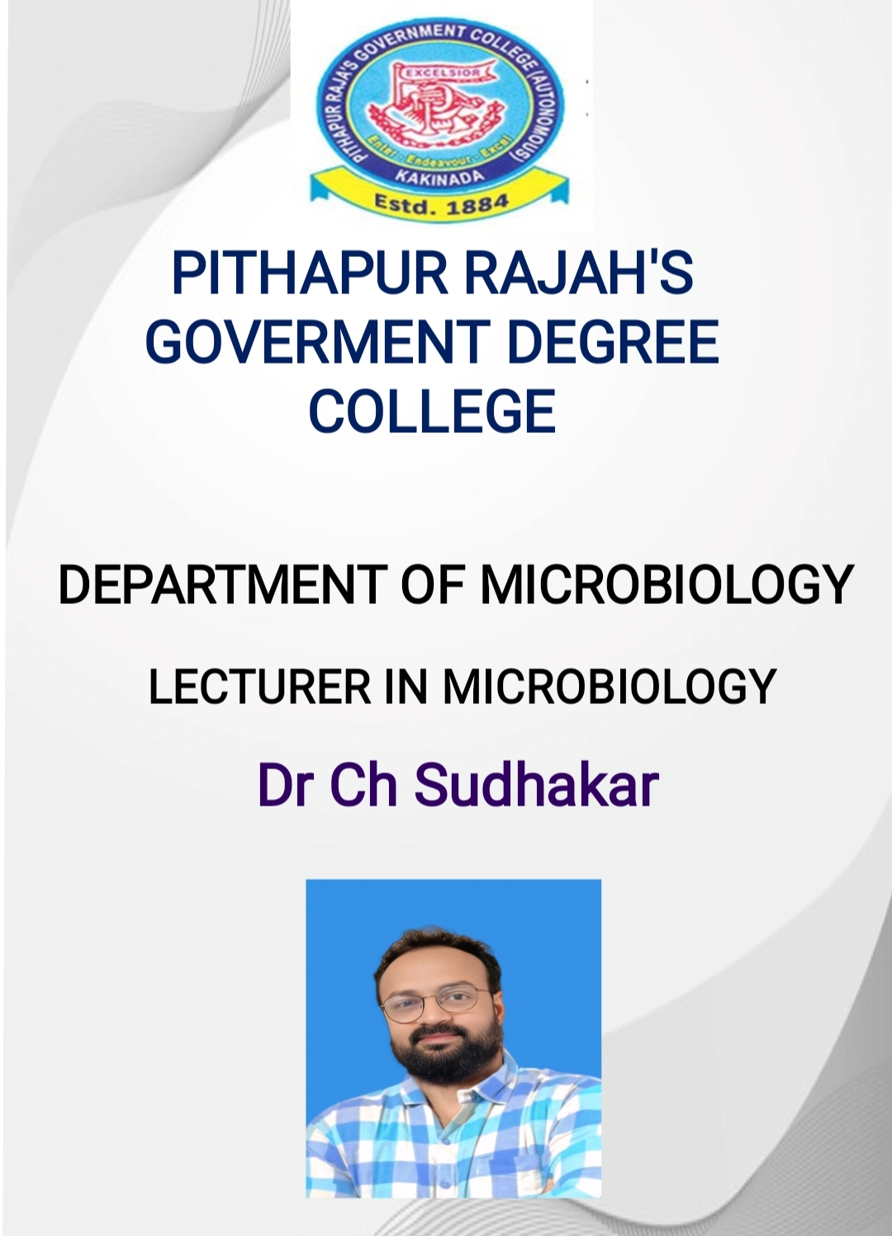

Slide 2

TITLE: INTRODUCTION TO APPLIED BIOLOGY

Slide 3
History of Microbiology
1. Microbiology began in the 17th century with microscopes.
2. Edward Jenner developed the smallpox vaccine.
3. Louis Pasteur disproved spontaneous generation.
4. Robert Koch discovered bacteria that cause diseases.
5. Joseph Lister introduced aseptic surgery.

Slide 4
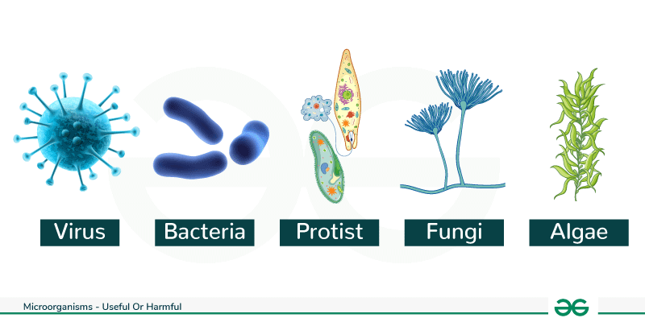
Groups of Microorganisms
1. Bacteria – Prokaryotic, cell wall, reproduce by binary fission.
2. Fungi – Eukaryotic, have hyphae, reproduce sexually/asexually.
3. Archaea – Like bacteria but live in extreme conditions.
4. Viruses – Not living, need host cell, DNA or RNA inside.

Slide 5
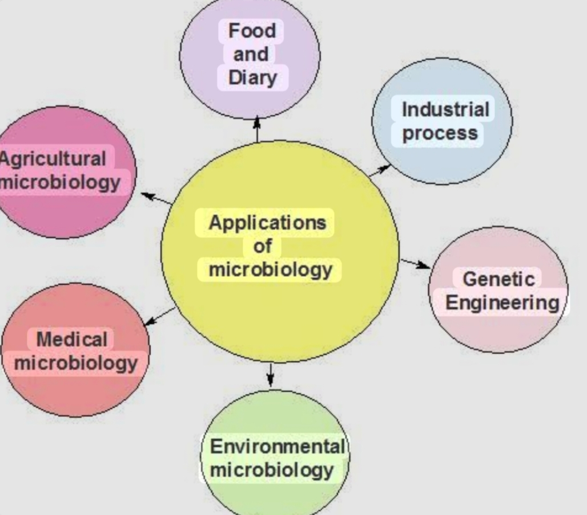
Applications of Microorganisms
1. Food – Yogurt, cheese by fermentation.
2. Agriculture – Nitrogen-fixing bacteria, biofertilizers.
3. Environment – Waste cleanup (bioremediation).
4. Industry – Enzyme and antibiotic production.

Slide 6
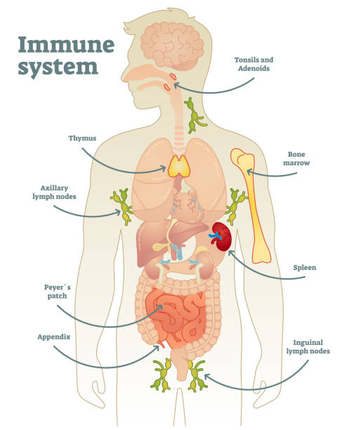
Immune System
1. Immunity – Body's defense system.
2. Types – Innate (natural) and Adaptive (specific).
3. Cells – WBCs like lymphocytes, macrophages.
4. Organs – Bone marrow, spleen, thymus.

Slide 7
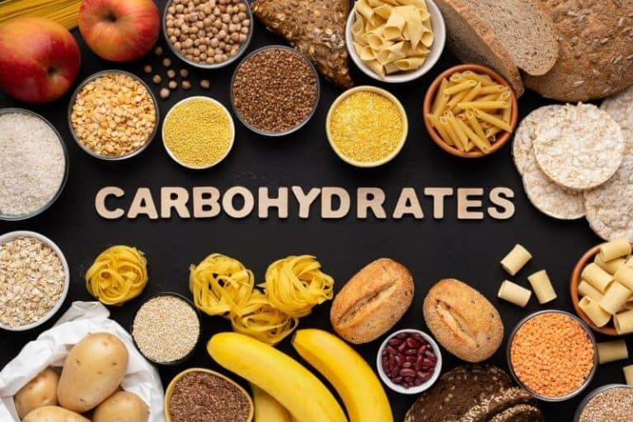
Carbohydrates
1. Provide energy.
2. Monosaccharides – glucose.
3. Disaccharides – sucrose.
4. Polysaccharides – starch, glycogen.

Slide 8
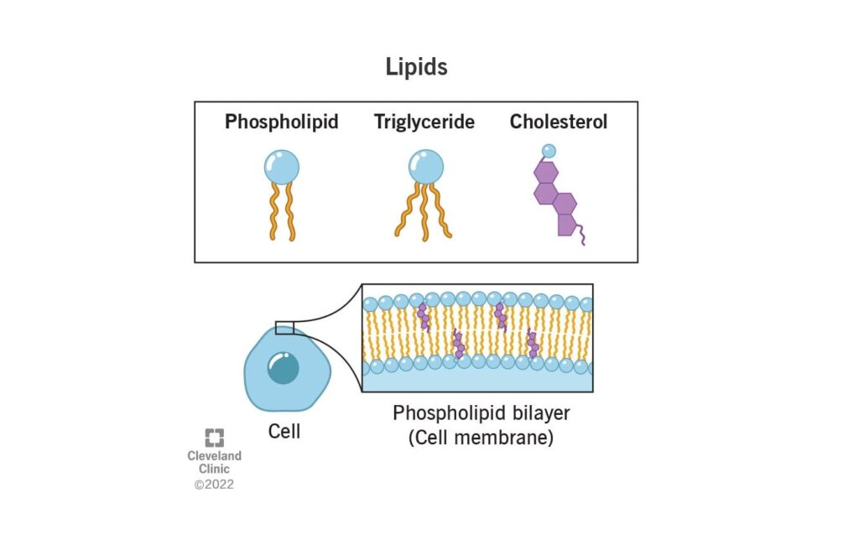
Lipids
1. Store energy.
2. Made of fatty acids and glycerol.
3. Types – fats, oils, steroids.
4. Found in cell membranes.

Slide 9
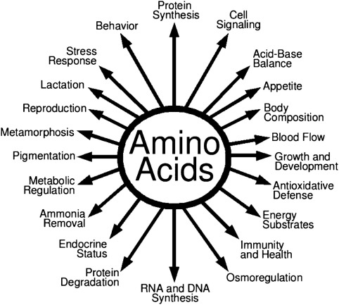
Amino Acids and Proteins
1. Building blocks of proteins.
2. 20 standard amino acids.
3. Proteins perform many functions – enzymes, hormones.
4. Structure: primary to quaternary.

Slide 10
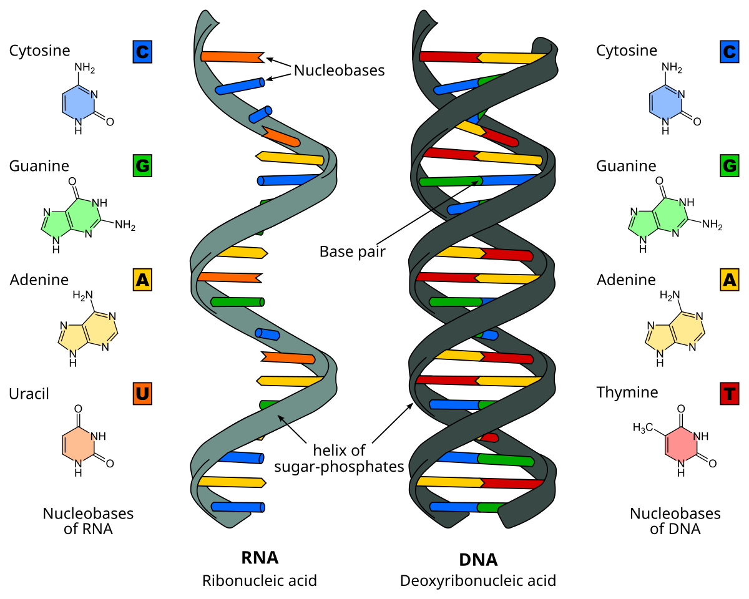
Nucleic Acids
1. DNA – stores genetic info.
2. RNA – helps in protein synthesis.
3. DNA made of A, T, C, G.
4. RNA has A, U, C, G.

Slide 11
Metabolism
1. Metabolism = all chemical reactions in the body.
2. Anabolism – builds molecules (e.g. proteins).
3. Catabolism – breaks down molecules (e.g. glucose).
4. Energy from ATP.

Slide 12
Introduction to Biotechnology
1. Use of living things for human benefit.
2. Scope – wide in health, food, and environment.
3. Historical roots in fermentation.
4. Important in agriculture and medicine.

Slide 13
Applications of Biotechnology
1. Plant – pest-resistant crops.
2. Animal – better breeds, more milk/meat.
3. Industrial – enzymes, biofuels.
4. Pharmaceutical – vaccines, insulin.

Slide 14
Environmental Biotechnology
1. Bioremediation – using microbes to clean pollution.
2. Biofuels – energy from biomass.
3. Biofertilizers – natural fertilizers.
4. Biopesticides – control pests naturally.

Slide 15
Genetic Engineering
1. Modify genes using biotechnology.
2. Restriction enzymes cut DNA.
3. Vectors carry new genes.
4. Gene transfer: physical, chemical, or biological.

Slide 16
Transgenic Plants and Animals
1. BT Cotton – resists insect pests.
2. Salt-tolerant plants – survive tough soil.
3. Transgenic animals – for research.
4. Used in disease studies.

Slide 17
PCR and DNA Fingerprinting
1. PCR – copies DNA.
2. DNA fingerprinting – identifies individuals.
3. Used in forensics.
4. Helps solve crimes and paternity cases.

Slide 18
ELISA and Immunoblotting
1. Detect antigens or antibodies.
2. ELISA – enzyme-linked test.
3. Immunoblotting – proteins on a gel.
4. Used in diagnosis (e.g., HIV).

Slide 19
Monoclonal Antibodies & Gene Therapy
1. Made from single immune cell.
2. Used to treat cancers and diseases.
3. Gene therapy – fix faulty genes.
4. Eugenics – controversial idea to improve genes.

Slide 20
Biostatistics
1. Data Collection – surveys, experiments.
2. Mean, Median, Mode – central values.
3. Range & SD – how spread out data is.
4. Tests – t-test, chi-square for significance.

Slide 21
Bioinformatics Tools
1. Study biological data using computers.
2. Genomics – study of genes.
3. Proteomics – study of proteins.
4. Use databases: NCBI, EBI, GenBank.

Slide 22
THANK YOU

